Slide 1

Donor Churn Prediction Maximizing impact
Habel Abdi
Notes:
. (churn" refers to the action of donors stopping their financial support or donations to a charity)

Slide 2
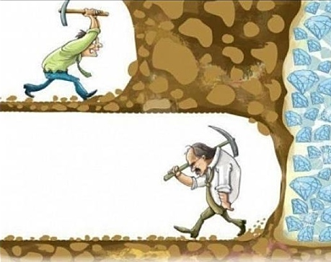
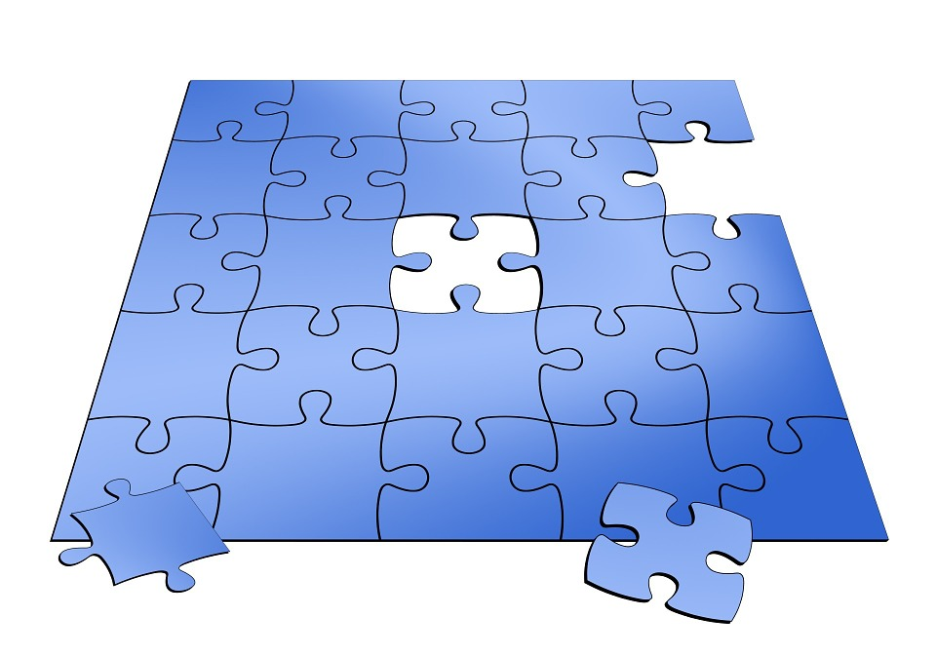

What Problem do charities face?
& Churn:
Charities miss opportunities to combat churn
CHARITIES lack clean, datasets, hindering their capabilities
CHARITIES STRUGGLE WITH UNDERSTANDING DATA. NON-LINEAR/LINEAR RELATIONSHIPS THAT GO UNNOTICED
Notes:
charities face 3 main problems in the data world
missed oppourtunties to combat Churn: (potential)
”UNABLE TO Detect potential churn before it happen.”
Resulting in spending thousdands if not millions trying to regain those donors instead of focusing on attainting new ones
Data Quality Concerns: (missing)
"Many charities lack clean, usable datasets, hindering their analytical capabilities.”
Forcing them to spray and pray with their marking and waste money hoping for things to stick
- Data Complexity: (confused)
" charities struggle with the whats hidden in their data, especially non-linear relationships that go unnoticed that COULD further help grow the charity.”
This project is an example of what could be possible if charities focused on trying to understand their data, obviously that comes with charities have decent data to start

Slide 3
Approach & methodology
Exploratory Data Analysis (EDA)
Missed Data, Outliers, Descriptive stats, Visualizations, Correlation Analysis
Feature engineering
Transformation, Encoding, Feature Importance
Model development
Model Selection, Hyperparameter Tuning, Model Comparison
Evaluation metrics
Accuracy, Precision, And ROC AUC.
Notes:
Handling Missing Data:
Outlier Detection
Detected outliers and removed them as the models being used are sensitive to outliers
Descriptive Statistics:
descriptive statistics to understand data distribution."
mean, median, and other measures
Data Visualization:
made complex relationships easier to grasp and supported decision-making."
Correlation Analysis:
Explored correlations between variables to understand
Feature Importance Analysis:
assessed the importance of different features
Identifying key features through plotting them on their own separate graphs
Model selection - In this case for me I have a classification problem, where my goal here to predict the likelihood of a donor churning
three distinct models - Linear Regression, Random Forest, and Gradient Boosting
selected Gradient Boosting due to its exceptional predictive capabilities.
Hyperparameter Tuning:
- Utilized GridSearchCV to fine-tune hyperparameters, ensuring the model's optimal performance

Slide 4
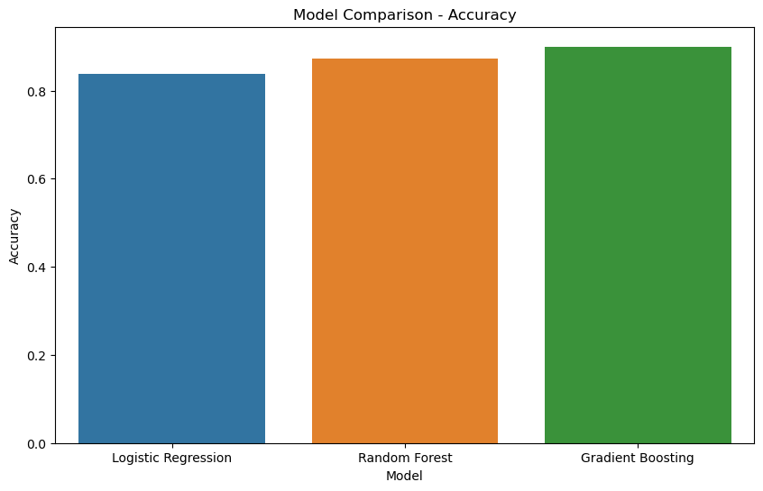
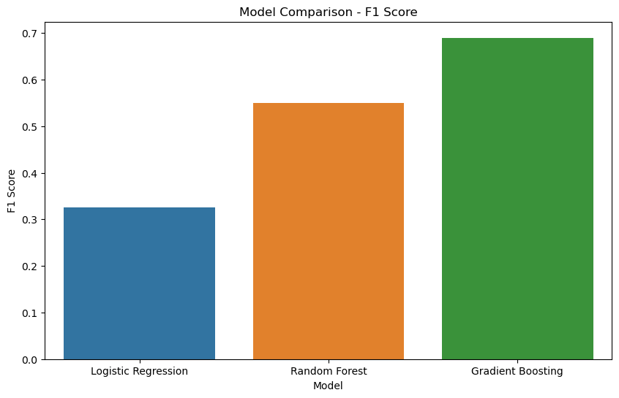
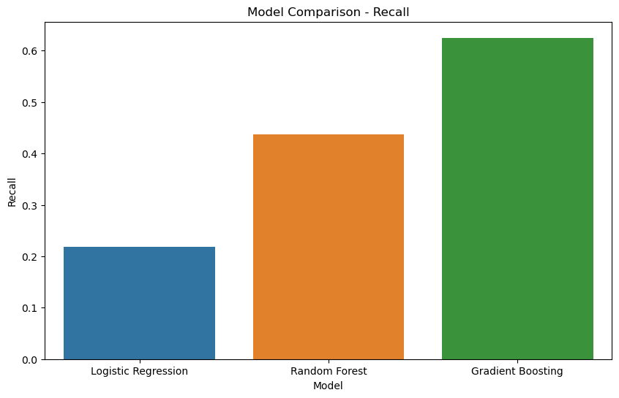
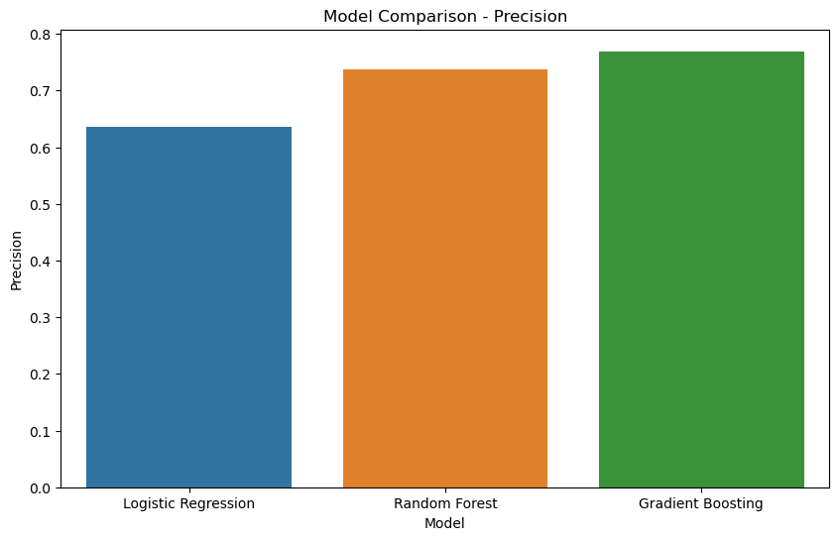
Model Comparison
Notes:
Accuracy:
Explanation: "Accuracy represents how often the model correctly identifies whether a donor will churn or not."
Precision:
Explanation: "Precision focuses on the accuracy of positive predictions. Specifically, it answers the question: Of the donors predicted to churn, how many actually churned?"
Recall:
Explanation: "Recall, or sensitivity, measures the model's ability to identify all relevant instances. In our case, it assesses how well the model captures all actual instances of donor churn."
F1 Score:
Explanation: "The F1 score is a balance between precision and recall. It's especially useful when the cost of false positives and false negatives is not equal.”
precision is about being right when the model makes a positive prediction, and recall is about capturing all the positive instances, even if the model makes some mistakes along the way.

Slide 5
Metric comparison table
+-------------------+----------+--------+---------+---------+
| Metric | Original | Tuned 1| Tuned 2 | Model |
+-------------------+----------+--------+---------+---------+
| Accuracy | 0.900 | 0.883 | 0.889 | GB |
| Precision | 0.769 | 0.739 | 0.773 | GB |
| Recall | 0.625 | 0.531 | 0.531 | GB |
| F1 Score | 0.690 | 0.618 | 0.630 | GB |
| ROC AUC | 0.792 | 0.745 | 0.749 | GB |
+-------------------+----------+--------+---------+---------+
The table illustrates the journey of key metrics across different model versions, emphasizing the fluctuations observed during hyperparameter tuning
Notes:
Gradient Boosting classification model,
the initial results were promising, showcasing strong metrics across the board. However, during the hyperparameter tuning phase, the first attempt yielded unexpectedly worse performance. The inherent randomness in the tuning process played a role. other tuning attempts demonstrated that, while not surpassing the original metrics, they showcased variations
This highlights the nuanced nature of model improvement. The challenge lies in deciding which metrics to prioritize, as improvements in one area may come at the cost of others."

Slide 6
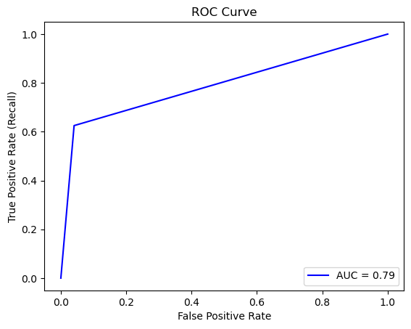
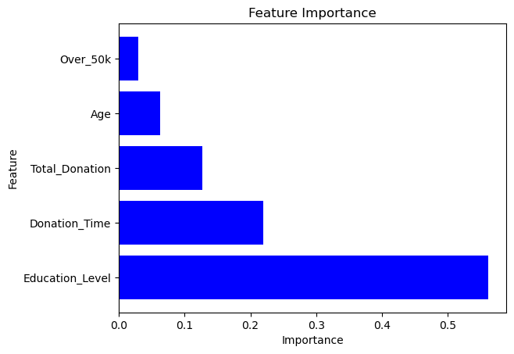
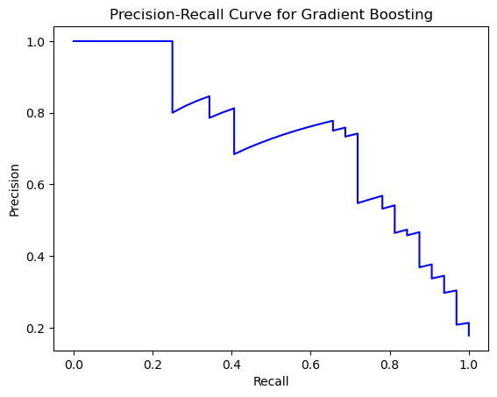
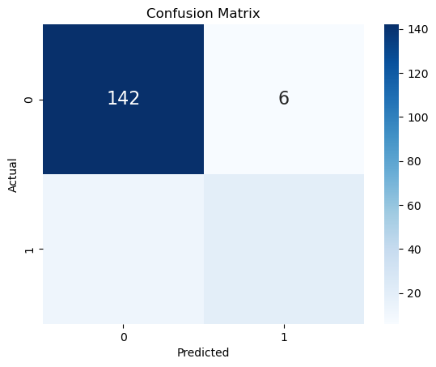
Notes:
ROC AUC Score:
Explanation: "The ROC AUC score evaluates the model's ability to distinguish between donors who churn and those who don't."
Explanation: "The trade-offs become evident during hyperparameter tuning, especially when aiming for improvements in specific metrics. For instance, increasing accuracy may impact precision or recall. The charity needs to decide whether pinpointing exactly who is churning is the priority or if predicting potential churners is more crucial, even with the risk of false negatives."
this provides clarity on the decision-making process during tuning, shedding light on the choices made to align the model with the charity's goals."

Slide 7
SUMMARY
The original model demonstrated robust performance, but hyperparameter tuning introduced trade-offs in precision, recall, and F1 score.
Charities face a dilemma: prioritize accurate predictions (limiting false positives) or identify most actual churn cases (minimizing false negatives).
The choice hinges on a charity's specific context, emphasizing the need to align model evaluation with unique goals and operational considerations.
Notes:
The charity needs to carefully assess these results based on its specific goals and preferences regarding donor engagement and retention strategies.
This approach is crucial when reaching out to donors demands significant resources or when the charity wants to be confident about the accuracy of its predictions. Also, it would look bad on the charity if they reached out to a donor who had no intentions of churning, but due to this miscalculation, they are considering it and now have a sour taste of being categorized as a churner.
On the other hand, some charities might focus on minimizing false negatives, ensuring that most actual churning cases are identified. This strategy is important when missing a donor who is likely to churn has significant consequences. The decision between these two approaches depends on the charity's unique context and objectives in managing donor relationships. This addition emphasizes the importance of tailoring the model evaluation based on the specific goals and operational considerations of the charity.

Slide 8
THANK YOU
Habel Abdi
Habeelabdi@gmail.com
https://github.com/HabelAbdi/Final-Project---Donor-Retention

